Slide 1
Stock Market Analysis Reliance Industries

Slide 2
Overview
Problem Statement
Exploratory Data Analysis
Model Building
Deployment

Slide 3
Problem Statement
Collect data of Reliance Industries Limited Stock Price from year 1990 to 2023.
For the Closing Price and Volume, make a forecast for the next 5 years, i.e. from 2024 to 2029.
Also find the factors that influence the stock prices and any special events during this period.
Using Stream lit, deploy the model with the best accuracy.

Slide 4
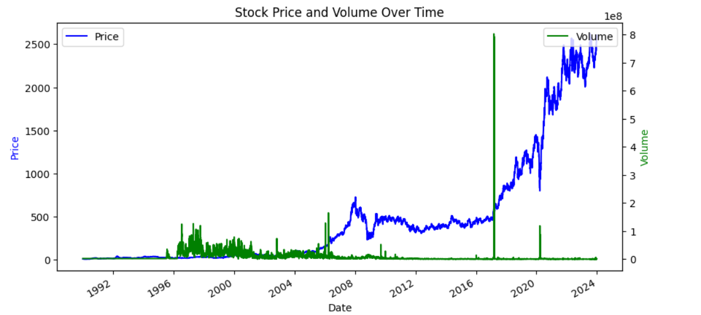
Exploratory Data Analysis

Slide 5
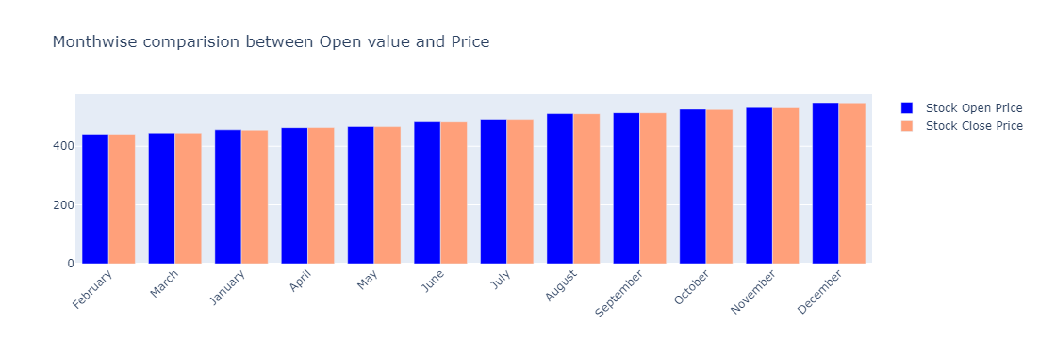
Exploratory Data Analysis

Slide 6
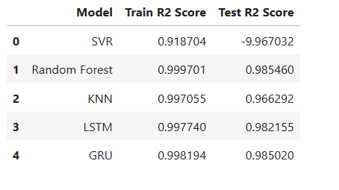
Model Building

Slide 7
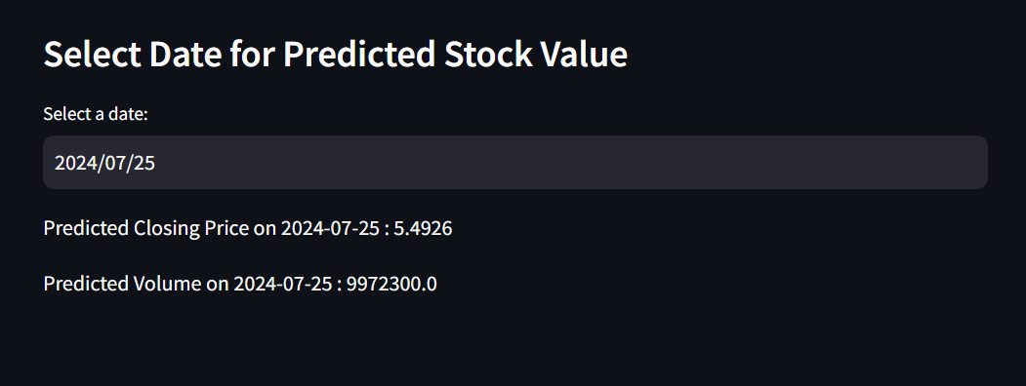
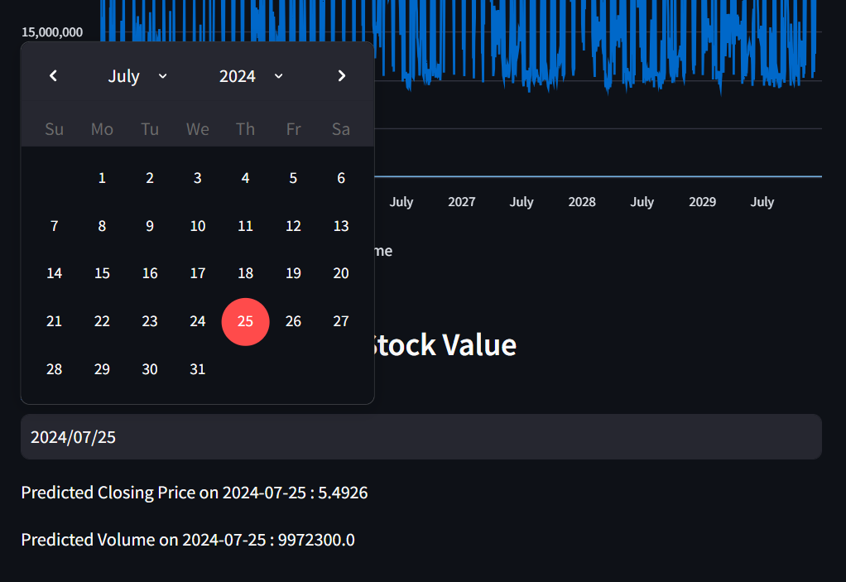
Deployment

Slide 8
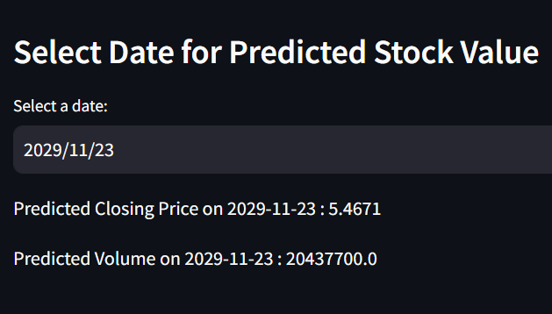
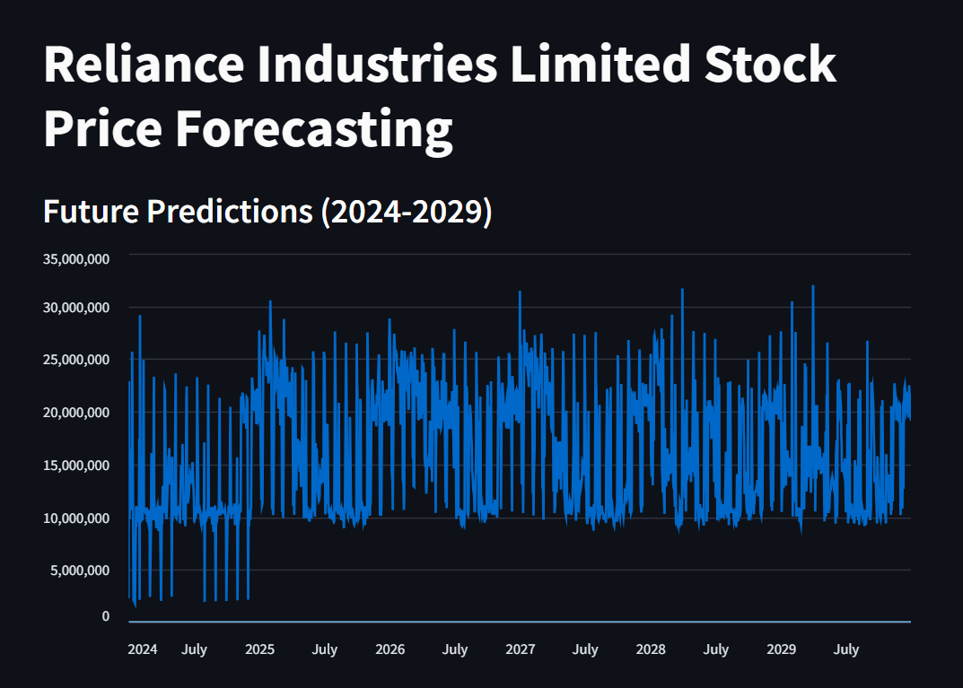
Deployment

Slide 9
THANK
YOU

